Slide 1
Test Driven Development Microskills
with Llewellyn Falco
Week 2

Slide 2
The Testing Circle
Native language
// Create side (0,0) – (3,4)
// Verify length
Whiteboard
English
Testing Circle
Print Result
Code
Side (0,0) – (3,4) length = 5
Side s = new Side(0,0,3,4);
Approvals.Verify(s + “ length = “ +s.Length);

Slide 3
Types of knowledge
PROFICIENCY
FLUENCY
AWARENESS
3

Slide 4
Benefits of Tests
Specification
Feedback
Regression
Granularity

Slide 5
Rules for Translating Test Scenarios
From the user perspective
You are writing what the user does, not what the program does
1.Get Shovel 2. Dig Hole 3. Place Pole…
setupFlagPole()
Edit
Improve on your 1st draft. The better your English is, the better the code will be. There will never be an easier time to refactor
Ask to make a game for the category of TicTacToe
Create a TicTacToe game
Verify Effect
Make sure you have the correct outcome
Place a ‘X’ at 1,2
Check X is at 1,2
Verify Cause
Make sure it happened for the right reasons
Check 1,2 is blank
Place a ‘X’ at 1,2
Check X is at 1,2
Complete
The world begins and ends with your test. Make sure it has everything it needs
Create a board
Check 1,2 is blank
Place a ‘X’ at 1,2
Check X is at 1,2
+
+
+

Slide 6
Arrange Act Assert
Notes:
Typical explanation of parts of a unit test

Slide 7
Arrange Act Assert
Given When Then
Notes:
The BDD parts (Behaviour Driven Development)
Equivalent

Slide 8
Arrange Act Assert
Given When Then

Slide 9
#1
TEST_CASE("Test Setup") {
TrigMath math; // Arrange
REQUIRE(math.DEG_TO_RAD == Approx(0.0174532925)); // Assert
}
#2
TEST_CASE("Test Function") {
auto result = pow(2, 3); // Act
REQUIRE(result == Approx(8)); // Assert
}
Notes:
Not everything has all 3 parts
Though Assert is required!

Slide 10
Arrange Act Assert
Given When Then
Notes:
You must have at least an arrange or an act.
Can’t just have an assert.

Slide 11
Do Verify
Notes:
So we think of it as…

Slide 12
2.
Practice – Translating Test Scenarios
Minesweeper
Tic tac toe
Othello (reversi)
chess
snake
checkers
battleship
natural sort
family tree
Shopping receipt
Anagrams
Bank account
Sudoku
Hangman

Slide 13
3.
Practice – Translating English to Code
Micro-API Design

Slide 14

Rules for Creating Code
Use your imagination
Write the code you want to exist, regardless of what currently does
array.isEmpty() ? null : array.get(0)
array.first()
Evaluate the consequences
Ask yourself “what are the resulting classes and methods from this implementation?”

Slide 15
4.
Practice – Triangles
A side has a distance
A side has endpoints
3 points
3 sides
Perimeter
Get Sides touching a point
Get sides opposite a point
The angle of 2 sides touching a point
3 angles
Right Triangle

Slide 16
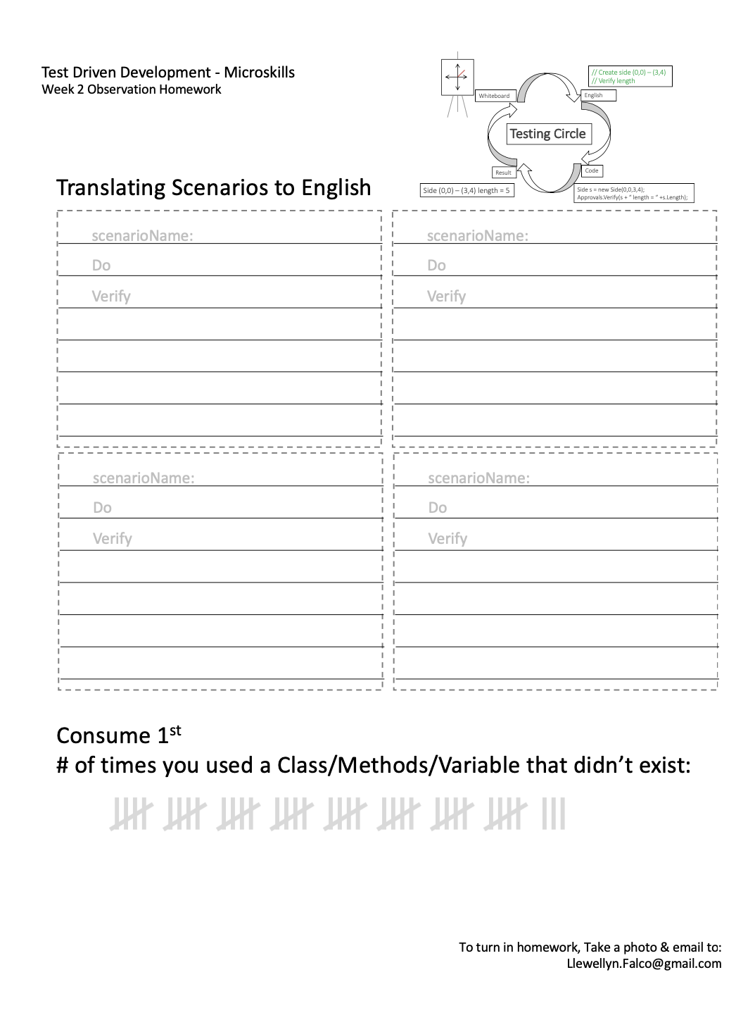
Homework
Write 4 scenarios
Count # times you used a class/method/variable that didn’t exist

Slide 17
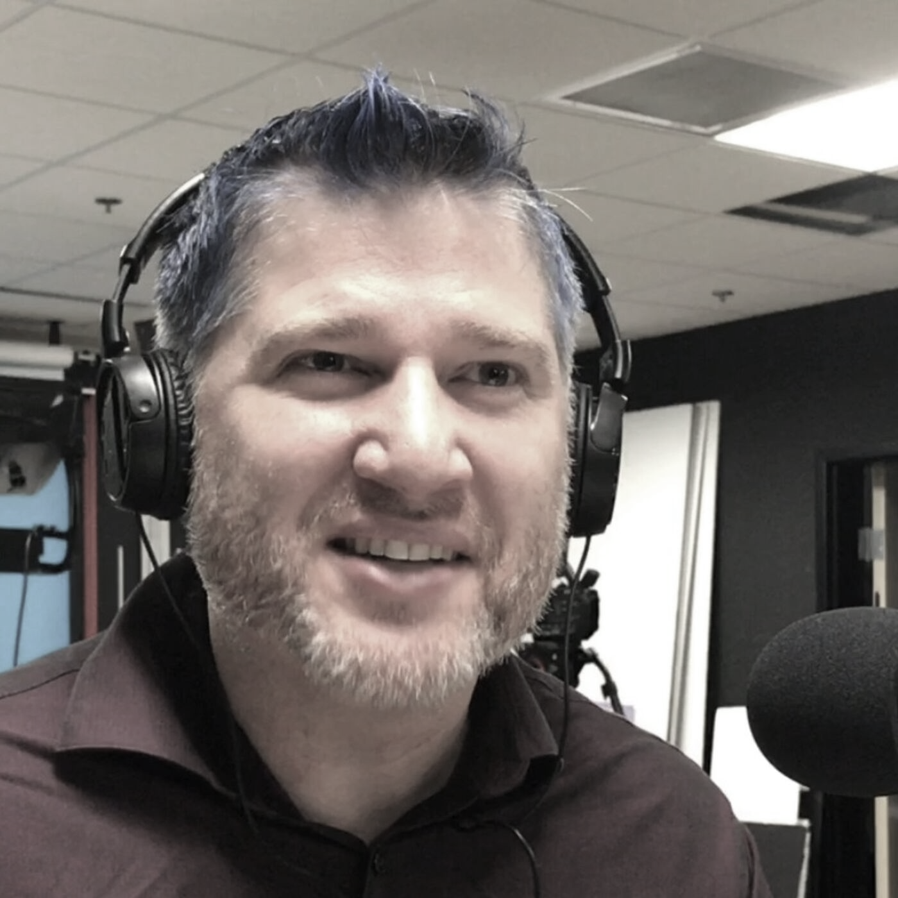
thanks!
Any questions?
Please connect through LinkedIn & Twitter
@LlewellynFalco
Llewellyn.Falco@gmail.com
Presentation template by SlidesCarnival

